Slide 1
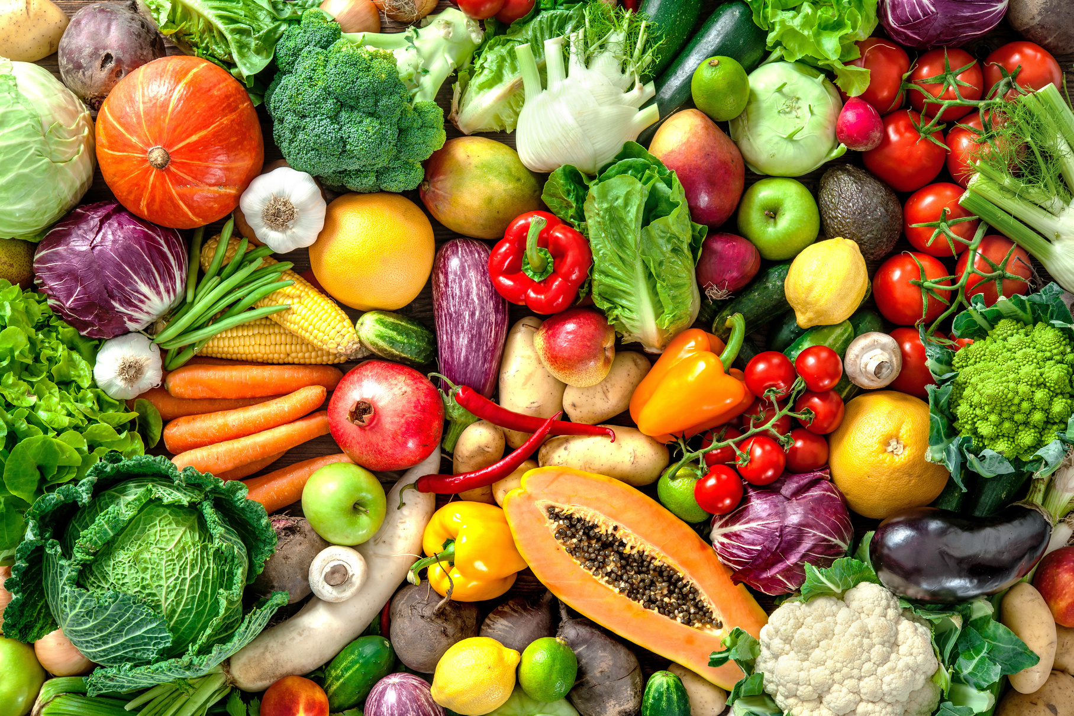

VEGETABLE IMAGE CLASSIFICATION AND QUANTITY ESTIMATION
Team - DataWarriors
Abhishek Nair
Priyanshi Furiya

Slide 2
PROBLEM STATEMENT
- IDENTIFYING VEGETABLES FROM IMAGES IS USEFUL FOR MANY APPLICATIONS LIKE MEAL PLANNING, NUTRITION TRACKING, AUTOMATED GROCERY SHOPPING ETC.
- MANUALLY TRACKING NEEDED QUANTITIES OF DIFFERENT VEGETABLES IS TIME CONSUMING.
- GOAL IS TO AUTOMATE VEGETABLE RECOGNITION AND QUANTITY ESTIMATION FROM IMAGES TO SIMPLIFY SHOPPING.

Slide 3
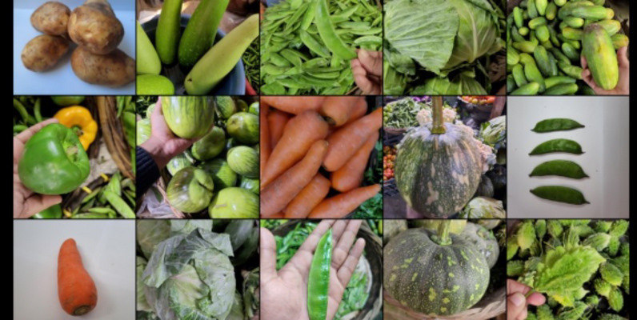
DATASET
01
02
Dataset has 15 vegetable categories: bean, bitter gourd, bottle gourd etc.
Total images: 21000+
Split into training (70%) – 15000 images , validation (15%) – 3000 images and test (15%) sets – 3000 images.
Augmented training data with rotations, shifts, flips etc. to reduce overfitting.
Dataset Link

Slide 4
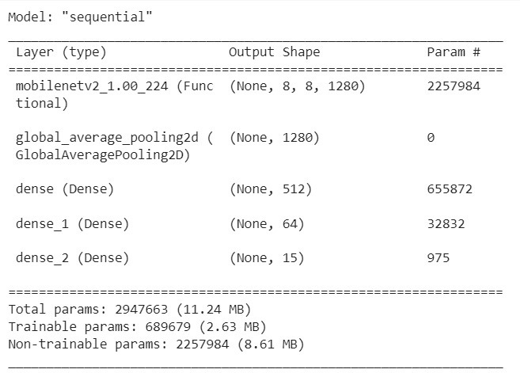
MODEL
ARCHITECTURE
USE MOBILENETV2 PRE-TRAINED ON IMAGENET AS BASE MODEL.
FROZEN BASE LAYERS PROVIDE GENERAL VISUAL FEATURES.
ADDED GLOBAL AVERAGE POOLING AND DENSE LAYERS AS CLASSIFIER HEAD.
2 RELU DENSE LAYER WITH 512 AND 64 LAYERS RESPECTIVELY
FINAL 15-WAY SOFTMAX LAYER GENERATES PROBABILITY DISTRIBUTION OVER VEGETABLE CLASSES.

Slide 5



TRAINING
Optimized with Adam and sparse categorical cross entropy loss.
Trained classifier head for 15 epochs keeping base model frozen.
Best model saved via callback.

Slide 6
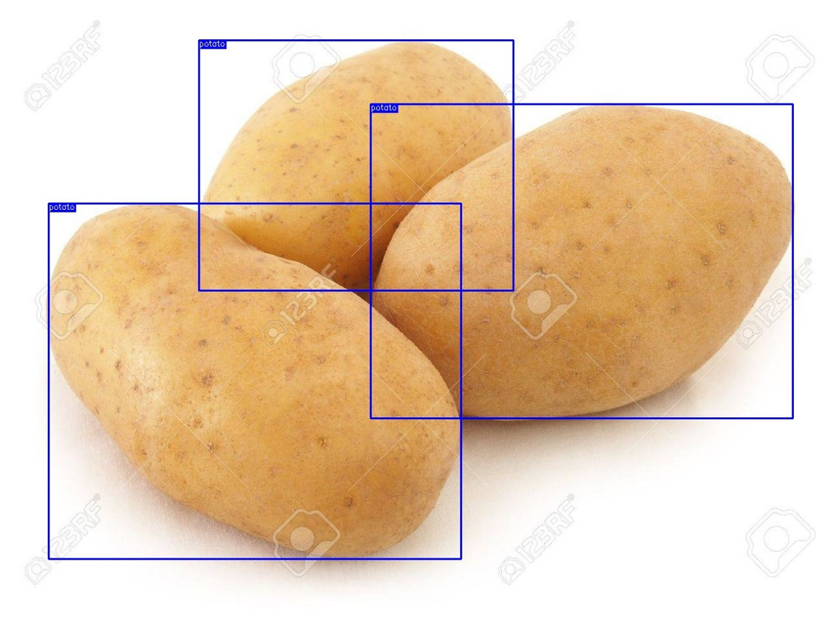
OBJECT DETECTION INTEGRATION
01
Added pre-trained Roboflow model to detect multiple instances of vegetables.
02
Faster R-CNN based model trained on separate veggie dataset.
03
Returns bounding boxes and class for each detected object.
Using a pretrained model from roboflow for quantity estimation and CNN cross validation

Slide 7
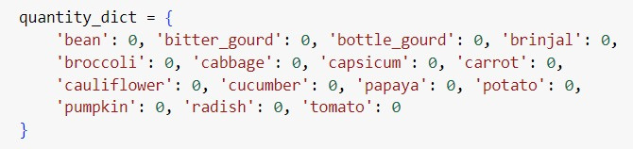

QUANTITY
ESTIMATION
01
Maintain dictionary with needed quantities of each vegetable.
02
Reduce counts as instances detected in new images.
Purchase List updates with each photo and subtracts the quantity detetcted from the list.
03
Update purchase quantities after processing each image.

Slide 8
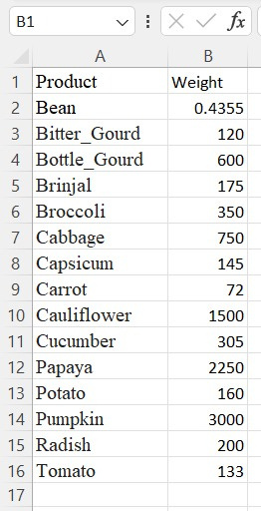
WEIGHT
CALCULATION
Map predicted vegetables to average weights from CSV data.
Multiply with estimated quantity to get total weight.
Useful to track nutrition information.
weight Mapping

Slide 9
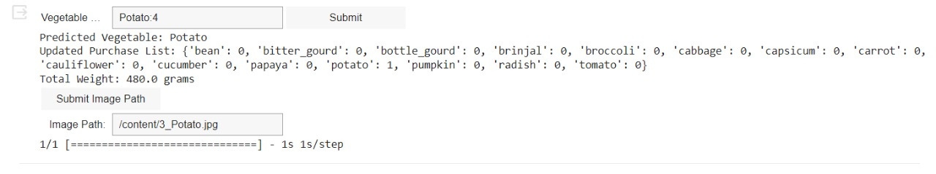
GUI AND INTERACTIVITY
Implemented a GUI for interactive usage using ipywidgets.
User can enter list of vegetables and quantities through a text input widget.
Quantity dictionary updated based on user input.
Image path entered via another text input widget.
Classification, detection and weight outputs shown after submitting image.
Live updating of purchase quantities and totals.
Interactive GUI provides easy usage for end users.

Slide 10

CONCLUSION
Successfully performed vegetable classification and quantity estimation.
Could improve accuracy, support more classes

